Slide 1


Unit Five
Aristocratic Spirit

Slide 2




CONTENTS
01
Lead-in
02
Tasks
03
Readings
04
More Resources

Slide 3

01
Lead-in

Slide 4

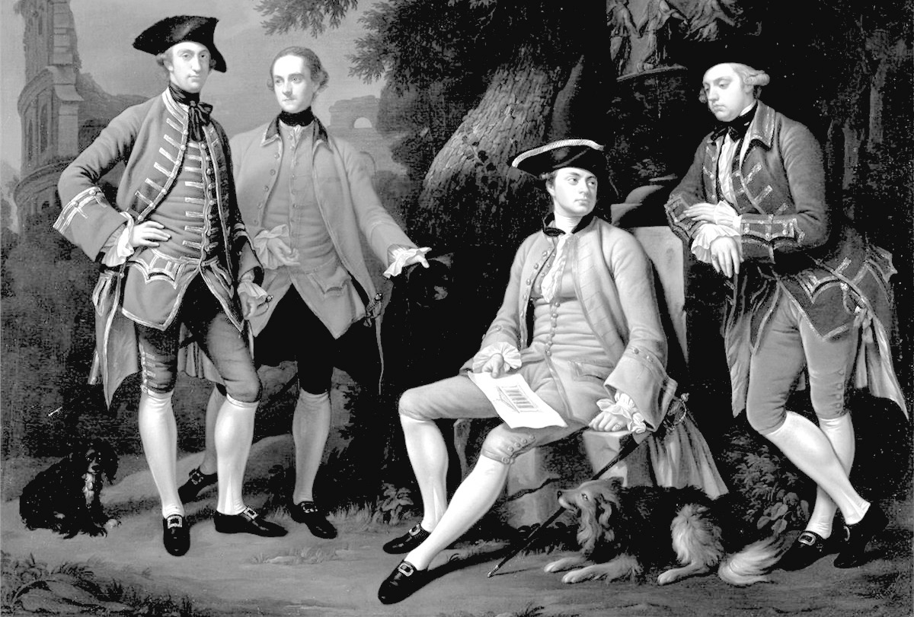
Lead-in
A. How much do you know about aristocratic spirit? Decide whether the following statements are true (T) or false (F).
( ) 1. Aristocracy is a form of government that places power in the
hands of a small, privileged ruling class.
( ) 2. In the Middle Ages and early modern era, aristocracies primarily
consisted of an influential aristocratic class, privileged by birth,
and often by wealth.
( ) 3. Nobility is a social class, normally ranked immediately under
royalty, that possesses more acknowledged privileges or
eminence than most other classes in a society, membership
thereof typically being hereditary.
T
T
T
PPT模板下载：www.1ppt.com/moban/ 行业PPT模板：www.1ppt.com/hangye/
节日PPT模板：www.1ppt.com/jieri/ PPT素材下载：www.1ppt.com/sucai/
PPT背景图片：www.1ppt.com/beijing/ PPT图表下载：www.1ppt.com/tubiao/
优秀PPT下载：www.1ppt.com/xiazai/ PPT教程： www.1ppt.com/powerpoint/
Word教程： www.1ppt.com/word/ Excel教程：www.1ppt.com/excel/
资料下载：www.1ppt.com/ziliao/ PPT课件下载：www.1ppt.com/kejian/
范文下载：www.1ppt.com/fanwen/ 试卷下载：www.1ppt.com/shiti/
教案下载：www.1ppt.com/jiaoan/
字体下载：www.1ppt.com/ziti/

Slide 5
Lead-in
B. Talk with your classmates and share your knowledge about the Four Lords of the Warring States in China’s history.
参考答案（请点击）

Slide 6
Lead-in
B. Talk with your classmates and share your knowledge about the Four Lords of the Warring States in China’s history.
参考答案：
The Four Lords of the Warring States were four powerful aristocrats of the late Warring States period of Chinese history who exerted strong influence on the politics of their respective states in the third century B.C. During this time, the king was a mere figurehead, and seven states led by aristocratic families competed for real power. Although they were not monarchs, four aristocrats stood out because of their tremendous military power and wealth: Lord Mengchang (Tian Wen) of Qi, Lord Xinling (Wei Wuji) of Wei, Lord Pingyuan (Zhao Sheng) of Zhao and Lord Chunshen (Huang Xie) of Chu. The Four Lords of the Warring States were renowned for their activities in the politics of their era as well as being the persona of their state respectively at the time; they also wielded influence via the cultivation and housing of many talented house-guests, who were learned men and tacticians.

Slide 7
02
Tasks

Slide 8
Tasks
Task One
Read Passage One and choose the best answer according to the passage.
C
1. Which of the following statements is NOT true about aristocratic spirit according to the passage?
A. In its classical sense, aristocratic spirit comes from noble families.
B. The word is originated from old English.
C. It means rule by the best.
D. The word differs in meaning from the common materialist life.
B
2. Which of the following is in accordance with what Berdyaev believes?
A. He thinks there is no relationship between aristocratic spirit and human spirit.
B. He believes that this spirit can bring peace to this world.
C. He has written a lot of books about orthodox Christianity.
D. He has shown great interest in Gnosticism.
文本内容
B
3. What is “a complete misunderstanding” according to the passage?
A. Men have been called aristocrats.
B. Societies narrow down the definition of aristocratic spirit.
C. We don’t take this spirit in a very complex way.
D. Aristocratic spirit is based on love.

Slide 9
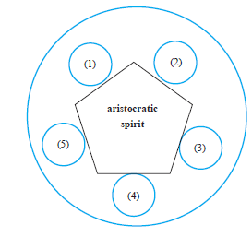

Tasks
Task One
Read Passage One and choose the best answer according to the passage.
4. Fill in the following blanks according to the passage based on the question “What qualities
does a noble man with aristocratic spirit have?”
love
文本内容
benevolence
excellence
subtlety
pervasive/penetrating
/attitude of mind

Slide 10
Tasks
Task Two
Read Passage Two and then answer the following questions.
1. What is the meaning of “Spirit of Liberty” by Judge Learned Hand?
参考答案：
He says that liberty cannot be saved by laws or constitutions but only if it “lies in the hearts of men and women.” What he means is that our constitutional guarantees of rights are useless if people don’t want to support them. For example, during his time, African Americans were denied to enjoy the equal protection of the law even though The 14th Amendment guaranteed it. If the majority is strongly against some form of liberty, it will die, even if the Constitution guarantees it.

Slide 11
Tasks
Task Two
Read Passage Two and then answer the following questions.
2. How do you understand “A society in which men recognize no check upon their freedom soon becomes a
society where freedom is the possession of only a savage few—as we have learned to our sorrow”?
参考答案：
Judge Learned Hand says it is not the freedom to do whatever we want. That is not the kind of liberty he is talking about. Instead, he says, liberty is more about toleration. He says a person with the spirit of liberty in them does not believe they are always right. They accept that they may be wrong so they allow others to have their own opinions. A person with the spirit of liberty in them tries to understand other people and to think about what other people want and need. They do not automatically think that something is bad if it is bad for them. Instead, they think about whether the thing might be good for others or might be something that others feel is important. Finally, he says, referring to Jesus, the spirit of liberty is the idea that the needs and ideas of the poorest and weakest will be paid attention to just as much as the needs and ideas of the richest and most powerful.

Slide 12
Tasks
Task Three
Read Passage Three carefully and then translate the following sentences into Chinese.
1. All things that have passed are just like this! Night and day it never stops.
译文：逝者如斯夫，不舍昼夜。
2. At fifteen I set my heart on learning. At thirty, I could stand firm. At forty I had no doubts. At
fifty I knew the Decree of Heaven. At sixty, I was ready obedient (to this decree). At seventy I
could follow the desires of my mind without overstepping the boundaries (of what is right).
文本内容
译文：吾十有五而志于学，三十而立，四十而不惑，五十而知天命，六十而耳顺，七十
而从心所欲，不逾矩。

Slide 13
Tasks
Task Three
Read Passage Three carefully and then translate the following sentences into Chinese.
3. In old days, men had three failings, which have perhaps died out today. The impetuous of old days
were impatient of small restraints; the impetuous today are utterly insubordinate. The dignity of old
days was stiff and gravely reserved; the dignity today is touchy and quarrelsome. The simple men
of old days were straightforward; the simple men today show themselves in sheer deceit.
文本内容
译文：古者民有三疾，今也或是之亡也。古之狂也肆，今之狂也荡；古之矜也廉，
今之矜也忿戾；古之愚也直，今之愚也诈而已矣。（古代人有三种毛病，今
人或许已经没有了。古人张狂是志大才疏，今人张狂却放荡不羁；古人自傲
是棱角分明，今人自傲却蛮不讲理；古人愚钝是直来直去，今人愚钝却不过
装样子骗人罢了。

Slide 14
Tasks
Task Four
Read Passage Four which explains the concept “aristocracy” in both Western and Chinese perspectives. And decide whether the following statements are true (T) or false (F).
( ) 1. In the classical sense, “aristocracy” means the ranks of the elite who are wealthy and powerful.
( ) 2. Rome’s senatorial aristocrats didn’t rely heavily on blood tie to maintain their ranks and
prestige.
( ) 3. Chinese feudal aristocrats were different from Roman’s. Most of the Chinese counterparts
inherited their titles.
( ) 4. Both Chinese and Roman feudal aristocrats cherished the bond of family and chose not to fight,
even though military victory was the highest glory for them.
( ) 5. Unlike the Roman’s, Chinese aristocracy enjoyed the advantage of a corporate organization,
concentrating aristocratic power and instituting laws to resolve disputes.
T
F
T
F
F

Slide 15
Tasks
Task Five
Read Passage Five and answer the following questions.
1. How did Nietzsche define “the noble person”? How do you define it?
参考答案：
According to Nietzsche, the person who suffers greatly but will bear it for the sake of the higher purpose is “the noble person”.

Slide 16
Tasks
Task Five
Read Passage Five and answer the following questions.
2. What did “nobility” mean in ancient Greece?W hat’s it like in the Bible and in the modern philosophy？
参考答案：
In Ancient Greece:
Aristotle makes clear that the noblest trait that a person can have is virtue, which is also described as pure “beauty”. When someone does things for the most beautiful reason, the actions are also the most virtuous, and mark the true noble person. Socrates, when he chose death over exile and dishonor in his trial, displayed this true nobility — he would rather die for the truth than disown it, even though he was accused of corrupting the youth. In Plato’s famous book Republic, the leaders of his ideal society display this same characteristic, honoring virtue and truth above all else, showing that the inner sense of nobility is the criterion to assume the outer role of noble leadership in a perfect society. （接下页）

Slide 17
Tasks
Task Five
（接上页）
In the Bible:
Although the Bible does spend an extraordinary amount of time tracing bloodlines in order to determine nobility in the conventional sense, it does also touch upon the deeper meaning of the word in several key ways. The prophet Isaiah for example, states clearly that nobility is based on virtuous thought and action: “But the noble make noble plans, and by noble deeds they stand”. Jesus in fact did claim to be a king, even though he was mocked by the conventional “nobility” of both the Romans and the Jews, but he proved his divine nobility through the teaching of virtues.
In the Modern Philosophy:
Nobility is based on individual achievements instead of birth. A noble person is one who is free of vanity and involved in a virtuous creative project that leads him to a good and healthy life. According to Nietzsche, the noble person may also suffer greatly, but will bear it for the sake of the higher purpose.

Slide 18
Tasks
Task Five
Read Passage Five and answer the following questions.
3. Is there anything that we can learn from the ancient aristocratic spirit? How does the ancient
aristocratic spirit nourish the modern world? Why do you think so?
参考答案：
We can learn more about humanity. The ancient aristocratic spirit shows us how to be a noble person and ask questions about the world. It is the humanity that develops informed and critical citizens. Without the humanity, democracy could not flourish.

Slide 19
Tasks
Task Six
Read Passage Three and share your opinions with your classmates.
Ren as mentioned in Passage Three, is one of the two core concepts of Confucius’s doctrine about people. When his student Fan Chi asked him about Ren, Confucius replied, “Love of people.” The Doctrine of the Mean (Zhongyong) further emphasized that this kind of love as “love of people” should “begin with the love of one’s parents”. Confucius also said, “Children should not travel far while their parents are alive. If they have no choice but to do so, they must retain some restraint.”
Questions:
1. Did Confucius mean that children should not leave their parents at all?
2. How much do you know about the concept of Ren?
文本内容
参考答案（请点击）

Slide 20
Tasks
Task Six
参考答案：
1. Confucius did not mean that children should not leave their parents at all. What he meant was that children should not make their parents anxious about them while away from home. Confucius said, “Children should think often of the age of their parents. They should feel happy for the health and longevity of their parents. They should also concern for the aging of their parents.” Parents’ both physical and mental health should be children’s concern no matter they are near or far.
文本内容
2. By Ren, Confucius held that universal love was based on love of one’s parents. How should people love one another then? Confucius said, “One should be aware that other people may have similar desires as oneself. While fulfilling one’s desires, allow others to fulfill their desires as well.” He further said, “Do not do toward others anything you would not want to be done to you.” Thus from oneself to one’s family, from family to society, one should extend love to all people. Mencius (c. 372-289 BC), a great Confucian scholar, summarized Ren as “loving one’s parents, loving the people, loving everything in the world.”

Slide 21
03
Readings

Slide 22
Readings
Passage One
Aristocracy of the Spirit
The term aristocracy of the spirit may seem pretentious or arrogant, especially if it comes from those who think they are better than others or have a right to flout the laws that bind “lesser” mortals. The notion can lead to the worst spiritual pride imaginable. I have found this term in the various writings of Nicholas Berdyaev and others who were interested in an orthodox Christian form of Gnosticism as expressed in the Alexandrian school. This
aristocracy n. 贵族；上层社会
pretentious adj. 自命不凡的；炫耀的
flout v. 嘲笑；轻视；愚弄
Nicholas Berdyaev 尼古拉斯· 别尔嘉耶夫（20 世纪最有影响的俄罗斯思想家之一，以理论体系庞杂、思想精深享誉西方世界）
orthodox adj. 正统的；传统的；惯常的；东正教的
Gnosticism 诺斯替教（初期基督教的一派，公元1-3 世纪流行于地中海东部各地。诺斯替教是罗马哲学和东方神秘教混合而
成的宗教体系，认为物质和肉体都是罪恶的，只有领悟神秘的“ 真知” 才能使灵魂得救。）

Slide 23
Readings
Passage One
theme is implicit in the whole Romantic way, whether in the early 19th century, or at any other time when spiritual humanity reacted from the excesses of reformations, cruelty, rationalism, technology and socialism.
I always like to define words carefully. Aristocracy, in its classical meaning, describes those who are born of noble families close to or even related to the royal family of a country. It means excellent or best. Aristocracy also means rule by a small elite of the best. In ancient Greece, it was thought as a rule by the best-qualified, contrasted to rule by an individual who was born of a royal family. Later, aristocracy was contrasted with democracy. Berdyaev uses these terms by way of an analogy to describe the human spirit and contrast those who live above the common materialistic life of most people.

Slide 24
Readings
Passage One
At such a critical moment as the present, when turmoil prevails everywhere and the Earth itself seems palpitating with violence, it is a strange situation, and somewhat sinister, that the one thing which would bring tranquility and an almost passionate return to the beautiful arts of peace, is the very thing which on all sides is now being flouted — I mean the aristocratic spirit.
Those who were born to this spirit, or who have by adoption made it their own, must always marvel that its inspiration and devout rule of life have not been seized upon with greater eagerness and by larger numbers. It must be that in the hurry of everyday life its claims have been overlooked by some, and misunderstood by others. There are, I think, three specific reasons why the aristocratic spirit has not made headway1against the more popular currents of the hour. They may properly be called the three antagonisms.
palpitate v. 发抖；（心脏）悸动；跳动
sinister adj. 阴险的；凶兆的；灾难性的
tranquility n. 宁静，平静
headway n. 前进
antagonism n. 敌对力量；敌意

Slide 25
Readings
Passage One
The most obvious and most excusable antagonism is also the most wide-spread. It is, like so many other antagonisms, the direct result of a quite complete misunderstanding. Men have been called aristocrats who were entirely untouched by anything as beneficent as the aristocratic spirit. Societies have been classed as aristocratic when in reality they were doing violence to the very fundamentals of that spirit. The term aristocracy has been made a term of reproach as the imputed possessor of the very qualities which it would itself be the first to deny. To answer the first antagonism, one has only to define the aristocratic spirit, but one must do it carefully. In reality, this spirit is subtle, pervasive, but it is not complex. It is as delicately simple as a child, and as easily understood, provided, of course, that one has not oneself wandered too far from the kingdom. I should define the aristocratic spirit as the love of excellence for its own sake. The aristocrat, to deserve the name, must love excellence everywhere and in everything; he must love it in himself, in his own beautiful body, in his own alert mind, in his
beneficent adj. 慈善的
reproach n. 责备
imputed adj. 假设的

Slide 26
Readings
Passage One
own illuminated spirit and he must love in others; must love in all human relations and occupations and activities, in all things in Earth or sea or sky. And this love of his must be so passionate that he strives in all things to attain excellence, and so tireless that in the end he arrives. But not even the hope of Heaven may lure him. He must love and work fairly, without the least thought of reward, enamored only of the transcendent beauty of excellence. It is his impersonal requirement which makes salvation at once so simple and so paradoxical, for it is literally true that to save one’s soul, one must lose it; one must go back to the kingdom of the child, where subject and object are one, and the unique reality is absorption in a universe.
If one accepts this simple and true definition of the aristocratic spirit, it becomes quite obvious that aristocracy is an attitude of mind, a religion, and not a social group. Aristocrats do not constitute a social class
illuminated adj. 受启发的
lure v. 诱惑
transcendent adj. 卓越的
paradoxical adj. 矛盾的，似是而非的

Slide 27
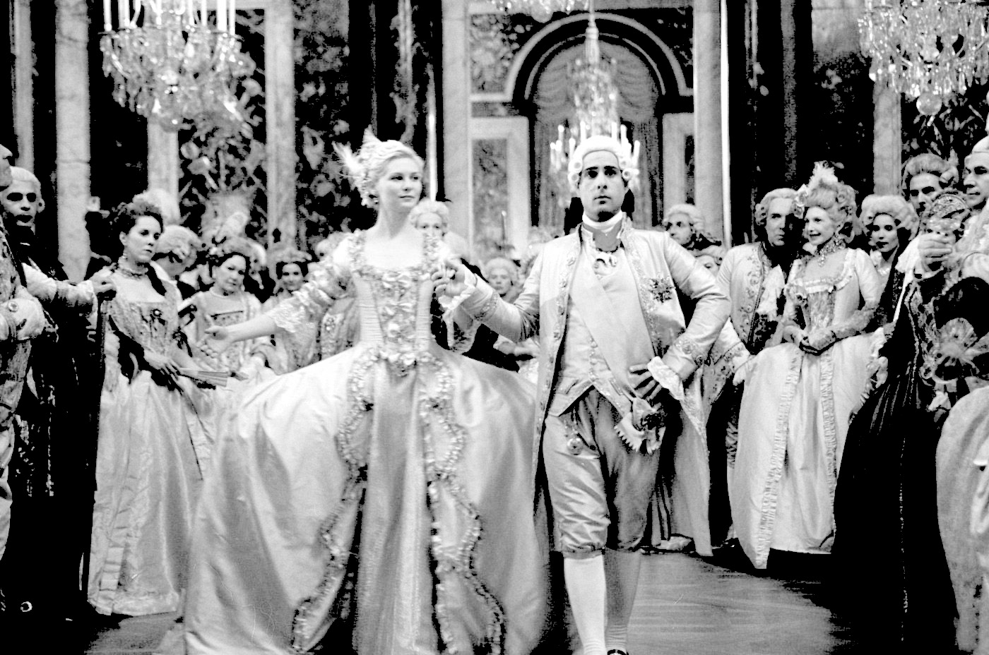
Readings
Passage One
in the concrete sense that laborers, or artisans, or professional men, or capitalists do. At most, aristocrats may be said to make up a party, since they are found in all classes of society. To be an aristocrat one must be the unselfish devotee of excellence, and happily such devotees are found in every walk of life, from the humblest to the most exalted. It is a grave mistake to confound aristocracy with social station, or with any other outer trapping. In the hot crucible of events, tinsel withers, while gold refines. The Great War has been such a crucible and it has put kings as well as commoners to the test. To love excellence, not the appearance of excellence, and to love it disinterestedly, and not for the sake of the
1
2
3
devotee n. 信徒
confound v. 使混淆；挫败
crucible n. 严酷的考验
tinsel n. 华而不实的东西

Slide 28
Readings
Passage One
the loaves and fishes — this is the whole reed of the aristocrat. When it is urged against the so-called aristocracies of the past that they were the class of privilege and prided themselves upon their exclusiveness, the criticism is perfectly just, but is not a criticism of the aristocratic spirit; it is evidence that this high spirit was sadly lacking. Greed, arrogance, snobbishness, cruelty can never be the qualities of an aristocrat. For the excellence which he seeks in the great outer world, he seeks still more passionately in himself.
snobbishness n. 势利

Slide 29
Readings
Passage Two
The “Spirit of Liberty” Speech
By Judge Learned Hand
We have gathered here to affirm a faith, a faith in a common purpose, a common conviction, a common devotion.
Some of us have chosen America as the land of our adoption; the rest have come from those who did the same. For this reason we have some right to consider ourselves a picked group, a group of those who had the courage to break from the past and brave the dangers and the loneliness of a strange land. What was the object that nerved us, or those who went before us, to this choice? We sought liberty — freedom from oppression, freedom from want, freedom to be ourselves. This then we sought; this we now believe that we are by way of winning. What do we mean when we say that first of all we seek
Learned Hand 勒恩德· 汉德（1872 —1961，被认为是美国20 世纪最有影响力的优秀法官之一，与卡多佐、布代斯、霍姆斯等联邦最高法院法官齐名。）
affirm v. 断言
conviction n. 信念

Slide 30
Readings
Passage Two
liberty? I often wonder whether we do not rest our hopes too much upon constitutions, upon laws, and upon courts. These are false hopes; believe me, these are false hopes. Liberty lies in the hearts of men and women; when it dies there, no constitution, no law, no court can save it; no constitution, no law, no court can even do much to help it. While it lies there, it needs no constitution, no law, no court to save it. And what is this liberty which must lie in the hearts of men and women? It is not the ruthless, the unbridled will; it is not freedom to do as one likes. That is the denial of liberty, and leads straight to its overthrow. A society in which men recognize no check upon their freedom soon becomes a society where freedom is the possession of only a savage few — as we have learned to our sorrow.
What then is the spirit of liberty?
unbridled adj. 无拘束的

Slide 31
Readings
Passage Two
I cannot define it; I can only tell you my own faith. The spirit of liberty is the spirit which is not too sure that it is right; the spirit of liberty is the spirit which seeks to understand the minds of other men and women; the spirit of liberty is the spirit which weighs their interest alongside its own without bias; the spirit of liberty remembers that not even a sparrow falls to earth unheeded; the spirit of liberty is the spirit of Him who, near two thousand
years ago, taught mankind that lesson it has never learned, but has never quite forgotten — that there may be a kingdom where the least shall be heard and considered sideby- side with the greatest. And now in that spirit, that spirit of an American which has never been, and which may never be — nay, which never will be except
unheeded adj. 未被注意的
nay adv. 不

Slide 32
Readings
Passage Two
as the conscience and courage of Americans create it — yet in the spirit of America which lies hidden in some form in the aspirations of us all; in the spirit of that America for which our young men are at this moment fighting and dying; in that spirit of liberty and of America so prosperous, and safe, and contented, we shall have failed to grasp its meaning, and shall have been truant to its promise, except as we strive to make it a signal, a beacon, a standard to which the best hopes of mankind will ever turn; I now ask you to rise and repeat with me this pledge:
I pledge allegiance to the flag and to the United States of America and to the Republic for which it stands — one nation, indivisible, with liberty and justice for all.
allegiance n. 忠诚

Slide 33
Readings
Passage Three
Ren and Li in Confucianism
Confucianism has played a major role in shaping the Chinese culture for thousands of years. Confucius was a sage who advocated good virtues and manners in which Ren and Li were two main concepts. His entire life was engaged in the perfection of one’s virtue as well as the prosperity, thus he maintained a very positive attitude towards life.
According to the Analects, Confucius once stood by a river and made a deep sigh in front of the passing water: “All things that have passed are just like this! Night and day it never stops”. However, he kept a very calm mind before the endless flow of time and thought he had done quite well by making positive remarks towards the life he had spent: “At fifteen I set my heart on learning; At thirty, I could stand firm; At forty I had no doubts; At fifty I knew the Decree of Heaven; At sixty, I was ready obedient (to this decree); At seventy I could follow the desires of my mind without overstepping the boundaries (of what is right)”.
sage n. 圣人
Ren n. 仁（儒家核心思想之一）
Li n. 礼（儒家核心思想之一）
prosperity n. （行为的）得体
Analects n.《论语》（记录孔子言行思想的著作）
decree n. 法令，旨意

Slide 34
Readings
Passage Three
Confucius lived in the Spring and Autumn Period, a time when wars broke out frequently and there was a decline in social morality. Hence, he was very dissatisfied with the situation and intended to reform society by looking back to the past for a good model. Although Confucius seemingly pointed out some shortcomings of the ancient men, his real intention was to express his appreciation of the ancient men and to pass criticisms upon the moral degeneration of the men in his time:
In old days, men had three failings, which have perhaps, died out today. The impetuous of old days were impatient of small restraints; the impetuous today are utterly insubordinate. The dignity of old days was stiff and gravely reserved; the dignity today is touchy and quarrelsome. The simple men of old days were straightforward; the simple men today show themselves in sheer deceit.
Spring and Autumn Period 春秋战国时期（公元前770 年－公元前221 年）
degeneration n. 退化；败坏
impetuous adj. 冲动的；鲁莽的
insubordinate adj. 不听话的；不顺从的
touchy adj. 敏感的；易生气的；难以取悦的
deceit n. 欺骗；谎言

Slide 35

Readings
Passage Three
Confucius and other philosophers of his day had different approaches to the solutions of the problems. The dominant view of that time espoused by Legalists was to adopt the strict law and severe punishment, while Confucius resorted to the rituals of the Zhou Dynasty: “The rituals of the Zhou Dynasty are inherited and developed from the two preceding dynasties Xia and Shang. How complete and elegant its rituals are! I follow upon Zhou”. Confucius interpreted the rituals of the Zhou Dynasty as a cultural legacy inherited from the former dynasties Xia and Shang, which developed through generations of human wisdom, thus he addressed himself as a “transmitter”but not “an originator”because of his “believing in and loving the ancients”. There was no doubt that Confucius was a great
espouse v. 支持
Legalist n. 法律学家；守法主义者
resort to 依靠，求助于
legacy n. 遗赠，遗产
transmitter n. 传达人，传播者
originator n. 先行者

Slide 36
Readings
Passage Three
sage who had established a unique system of social and ethical philosophy and whose thoughts had exerted a profound influence on the Chinese culture for thousands of years; nevertheless, he frankly attributed his thoughts to the rituals of the Zhou Dynasty. It was due to Confucius’ preference to the Zhou rituals that he developed his own concept of Li, a term not only referring to outside rites and ceremonies but also denoting graceful and civilized manners in one’s personality. Li has been one of the most important Confucius’s teachings.

Slide 37
Readings
Passage Four
Aristocracy and the Ruling Elite
The secular elite in many ancient societies are loosely called aristocrats. In the classical sense, “aristocracy” carries some connotation of the best, and “oligarchy” often implies rule of the rich. Combining a power elite with major components of a social elite, a cultural elite, and an elite of wealth, an aristocracy enjoys great privileges and licenses, which it jealously guards. Aristocrats deem themselves superior in status and virtue, and treat inferiors haughtily if not oppressively. They need not have hereditary ranks. Rome’s senatorial aristocrats were nonhereditary, as were imperial China’s literati-officials who constituted an “ideological aristocracy”. However, even those without heritable ranks rely heavily on blood tie to accrue prestige over generations.
secular adj. 世俗的；现世的
oligarchy n. 寡头政治
haughtily adv. 傲慢地；骄傲地
hereditary adj. 遗传的
senatorial adj. 参议院的；参议员的
literati-official n. 士大夫
ideological adj. 意识形态的
accrue v. 获得

Slide 38
Readings
Passage Four
Strong family bounds were common to the Roman and ancient Chinese aristocrats. Chinese feudal aristocrats had heritable ranks, fiefs, and ministries. The Roman did not; everyone had to win elections for magistracies. However, because of the restriction on candidacy, a small number of core families controlled government over centuries, even as the country expanded tremendously. A study of the Roman ruling circle found “new men” accounting for only about one fifth of all the consuls elected in the last 150 years of the Republic, and they tended to be local aristocrats from conquered territories.
Chinese feudal aristocrats were organized around the family, with relatives serving individual family state. Because the realm fragmented into hundreds of rivaling states, aristocratic power was greatly diffused
heritable adj. 可继承的
fielf n. 封地
magistracy n. 地方行政官的职位；地方行政长官
consul n. 领事
diffuse v. 传播

Slide 39
Readings
Passage Four
and fraught with internal disputes. The Chinese cherished private feelings and made the love of relatives the prime political principle. The Romans also cherished feelings; camaraderie of aristocrats was so strong that they tolerated defeated commanders in politics, even when military victory was the highest aristocratic glory. In addition, Republican Romans developed a strong public spirit. The Roman aristocracy enjoyed the advantage of a corporate organization, the Senate, which served a single state. The Senate concentrated aristocratic power and instituted laws to resolve disputes. The most important rules were the regular elections of magistrates who wielded active power and the passages of bills by the popular assemblies. By allowing the people to be the arbiters in aristocratic competition, they simultaneously mobilized the people’s pride and patriotism.
camaraderie n. 友情
wield v. 行使（权力等）
simultaneously adv. 同时地

Slide 40
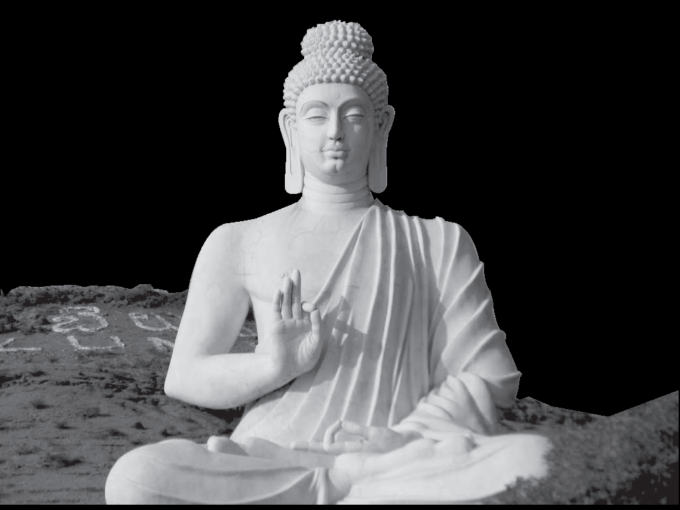
Readings
Passage Five
What Is a Noble Person?
Although nobility has often been associated with a position of high rank or heredity, the philosophical writings and spiritual texts of both East and West also point to a deeper sense of the word — where one’s moral and ethical predisposition, in other words virtue, is the true source of nobility. It is this inner sense of nobility that draws a natural respect from peers and society, that has been recognized throughout the ages in diverse cultures and times as the true mark of a noble person.
The Noble Person in Ancient Greece
Aristotle makes clear that the noblest trait that a person can have is virtue, which is also described as pure “beauty”. When someone does things for the most beautiful reason, the actions are also the most virtuous,
heredity n. 遗传，遗传性
ethical adj. 伦理的
predisposition n. 倾向；素质

Slide 41
Readings
Passage Five
and mark the true noble person. Socrates, when he chose death over exile and dishonor in his trial, displayed this true nobility — he would rather die for the truth than disown it, even though he was accused of corrupting the youth. In Plato’s famous book Republic, the leaders of his ideal society display this same characteristic, honoring virtue and truth above all else, showing that the inner sense of nobility is the criterion to assume the outer role of noble leadership in a perfect society.
The Noble Person in Buddhism
The essence of Buddhism revolves around the concept of building a noble person from virtuous thought and conduct. In fact, the most fundamental teachings of the Buddha are known as the “Four Noble Truths” which explain the formula for ending all suffering. According to the Buddha, all of our suffering comes from craving for outward forms and circumstances which leads to never-ending dissatisfaction,
disown v. 否认；脱离关系
craving n. 渴望

Slide 42
Readings
Passage Five
instead of developing inner states that lead to peace and contentment. The path out of this suffering is called the Noble Eightfold Path, a series of eight virtuous qualities — including right-mindfulness and right speech — that lead to enlightenment. There are four stages of enlightenment, and Buddha called those in these four stages “noble persons”.
The Noble Person in the Bible
Although the Bible does spend an extraordinary amount of time tracing bloodlines in order to determine nobility in the conventional sense, it does also touch upon the deeper meaning of the word in several key ways. The prophet Isaiah, for example, states clearly that nobility is based on virtuous thought and action: “But
contentment n. 满足，满意
bloodline n. 血统
prophet n. 先知，预言家
Isaiah 以赛亚（希伯来预言家）

Slide 43
Readings
Passage Five
the noble make noble plans, and by noble deeds they stand”. Isaiah is also one of the principal prophets that foresaw the birth of Jesus, and a future of world peace ruled by virtue. Jesus in fact did claim to be a king, even though he was mocked by the conventional “nobility” of both the Romans and the Jews, but he proved his divine nobility through the teaching of virtues.
The Noble Person in Modern Philosophy
The question of what constitutes a higher or noble person continues to occupy philosophy, although the most famous answers are remarkably similar to what the ancients have already stated. The German philosopher Nietzsche, for example, who includes himself along with Beethoven and Goethe as examples of nobility based on individual achievement instead of birth, has a very familiar answer. A noble person is one who is free of vanity and involved in a virtuous creative project that leads him to a good and healthy life. According to Nietzsche, the noble person may also suffer greatly, but will bear it for the sake of the higher purpose.
文本内容
vanity n. 虚荣；空虚

Slide 44
04
More Resources

Slide 45

More Resources
A. Enjoy the video about Xiang Yu (232–202 B.C.).
B. Surf the Internet.
http://www.tudou.com/programs/view/T18PEuMcgDs/
This video will tell you something about Xiang Yu. Xiang Yu was a prominent warlord in the late Qin Dynasty. A noble of Xiaxiang (present-day Suqian, Jiangsu), Xiang Yu was granted the title of Duke of Lu by King Huai II of the insurgent Chu state in 208 B.C. The following year, he led the rebel forces to victory at the Battle of Julu against the Qin armies led by Zhang Han. After the fall of the Qin Dynasty, Xiang Yu proclaimed himself Overlord of Western Chu and ruled a vast area of land. He engaged Liu Bang, the founding emperor of the Han Dynasty, in a long struggle for power, known as the Chu–Han Contention, which concluded with his eventual defeat at the Battle of Gaixia. He committed suicide at the bank of the Wu River.
1. http://global.britannica.com/topic/aristocracy
This website contains information about
the history of aristocracy.
2. https://en.wikipedia.org/wiki/Aristocracy
This website tells us what aristocracy is.
3. http://study.com/academy/lesson/aristocrats-
definition-examples-quiz.html
This website contains lots of both visual and
audio materials about aristocratic spirit.

